Slide 1
MASONRY HEATER BUILD
PHILIP GODFREY
611 RUE DES BOULEAUX
ST-DENIS-DE-BROMPTON,QUEBEC, CANADA

Slide 2
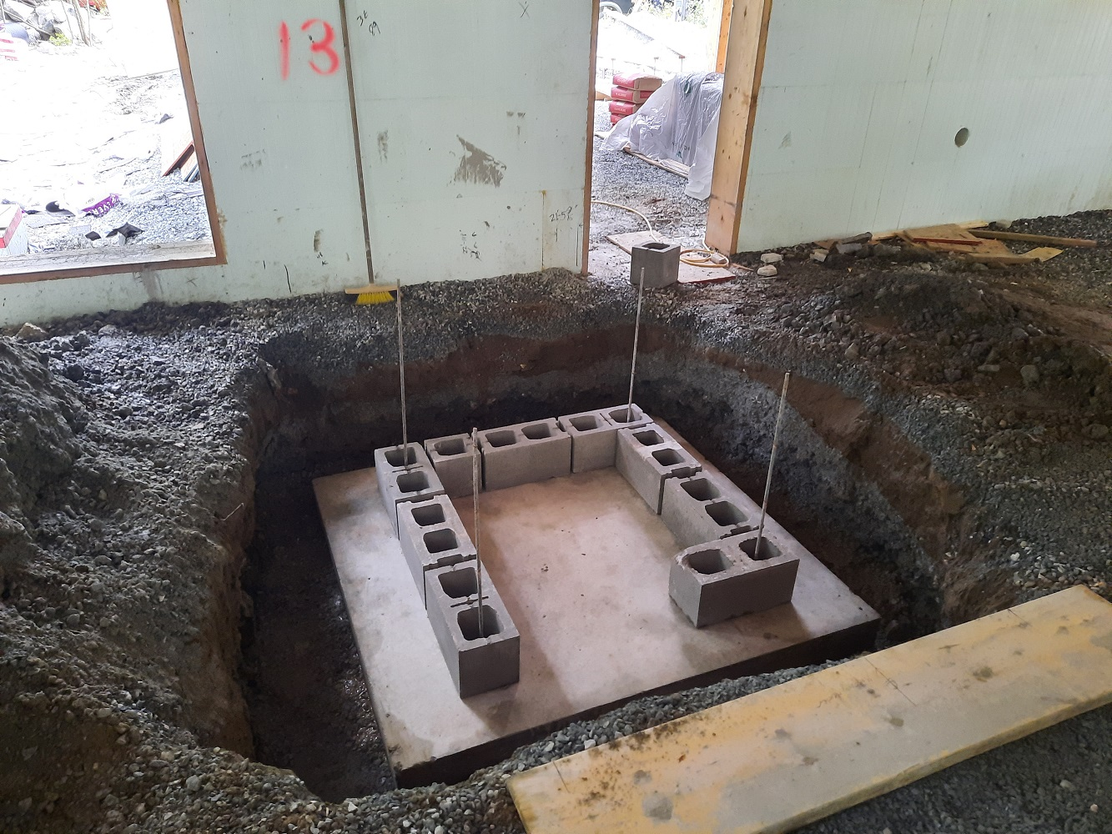
REINFORCED 11 ¼ INCH CONCRETE LOWER PAD WITH CINDER BLOCK WALLS

Slide 3
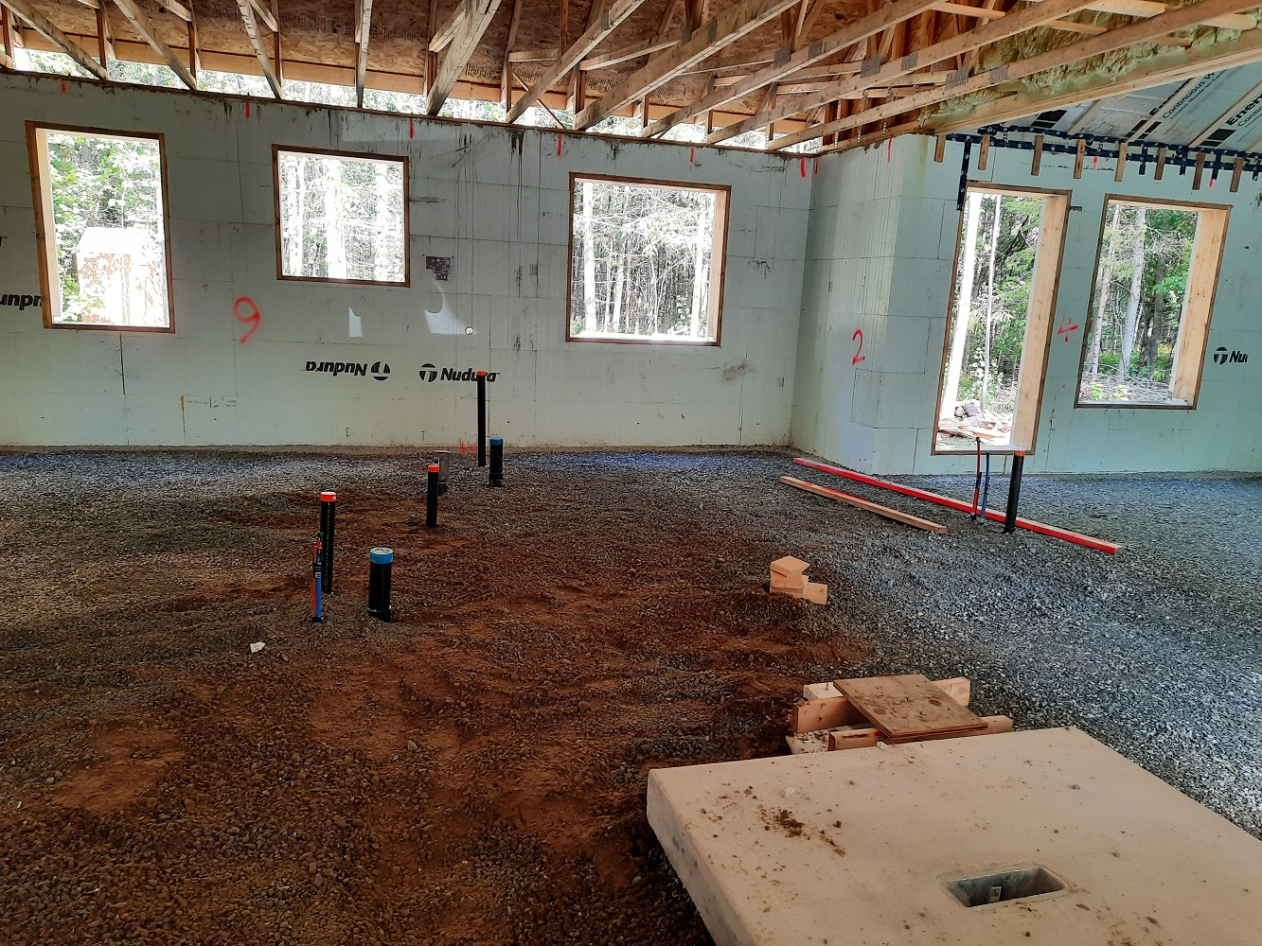
GROUND FLOOR REINFORCED CONCRETE PAD

Slide 4
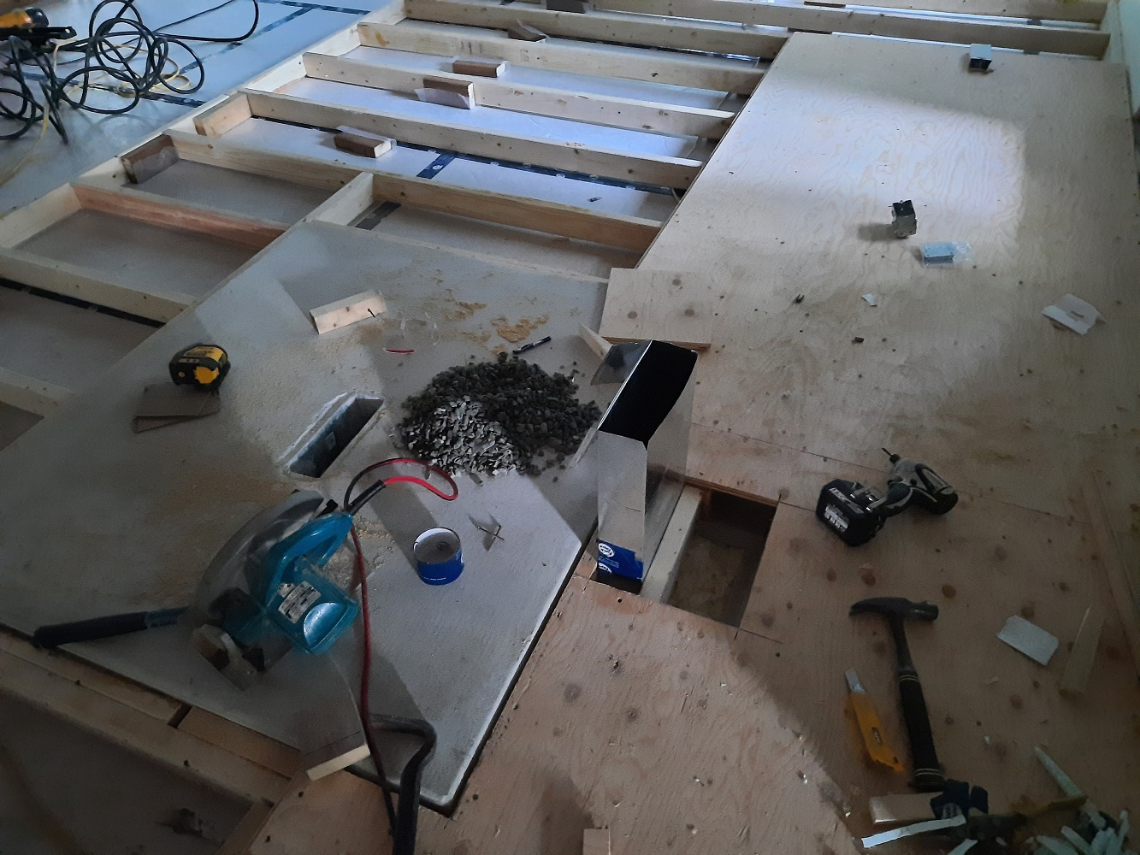
FLOOR STRUCTURE FIXED TO GROUND FLOOR PAD
FRESH AIR INTAKE

Slide 5
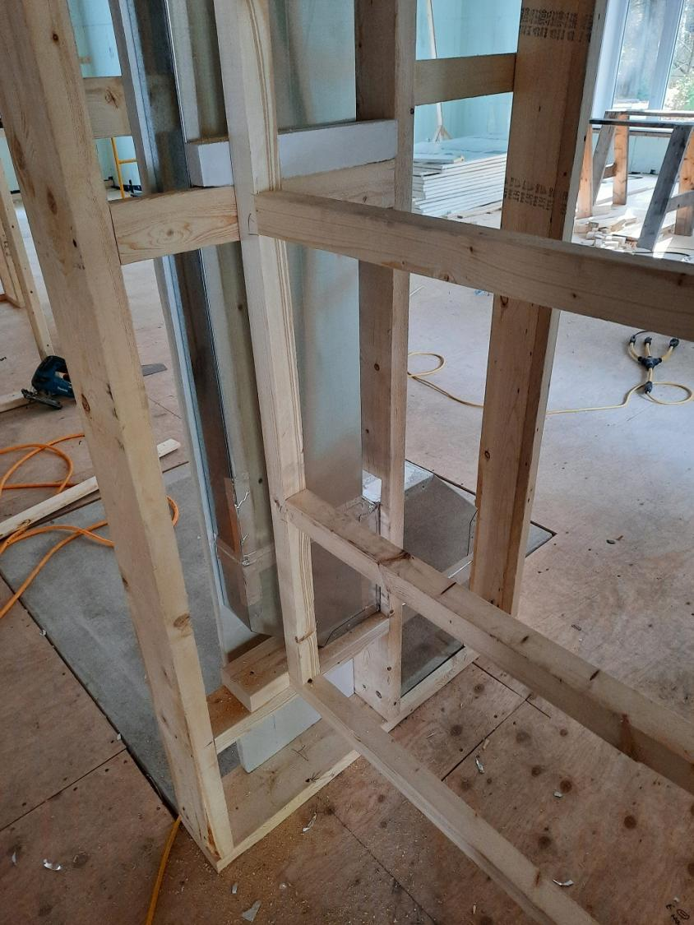
FRESH AIR INTAKE

Slide 6
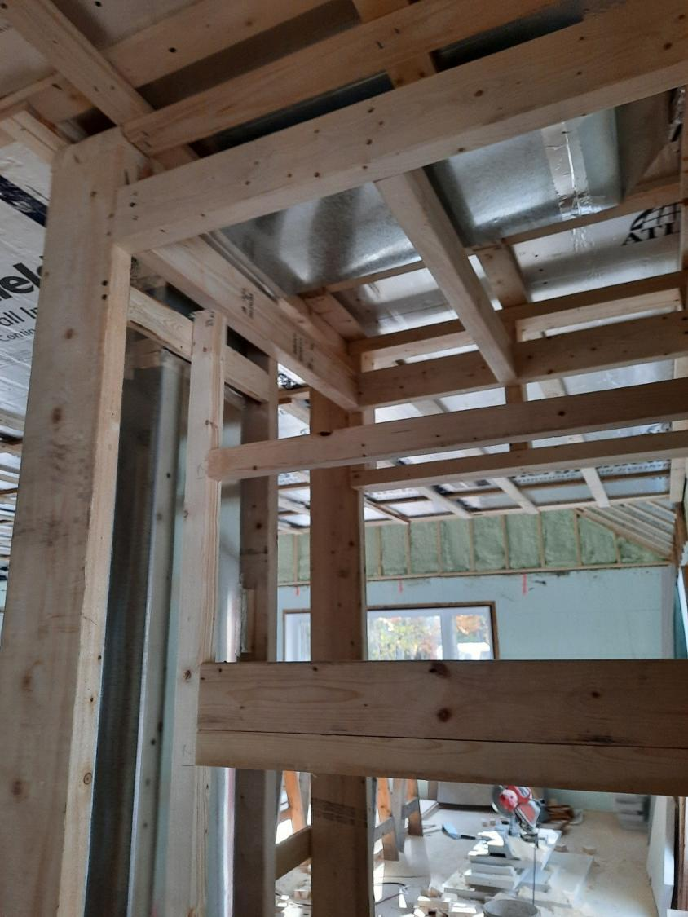
FRESH AIR INTAKE

Slide 7
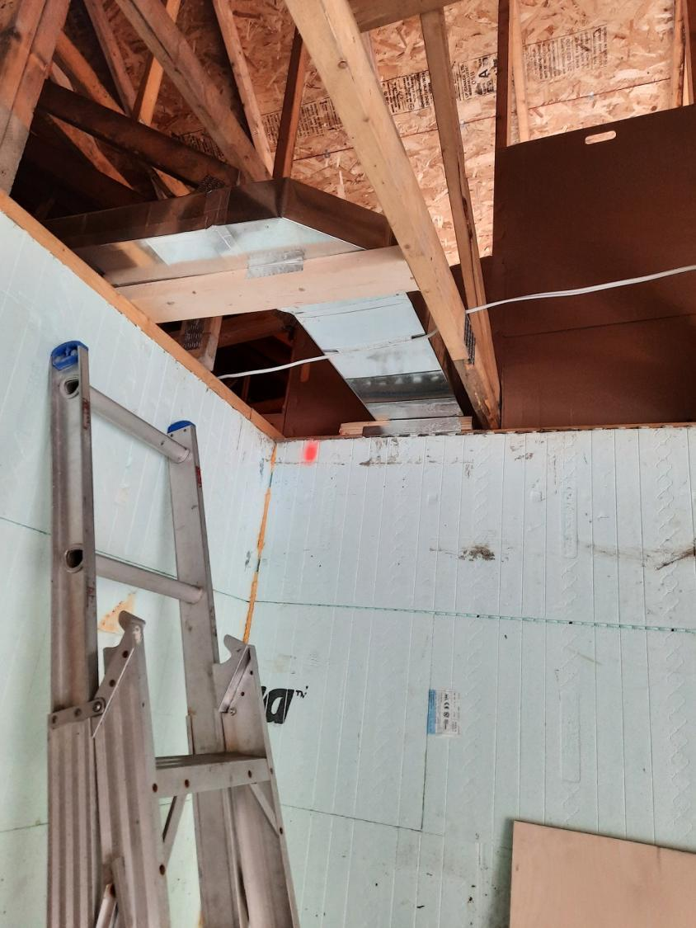
FRESH AIR INTAKE

Slide 8
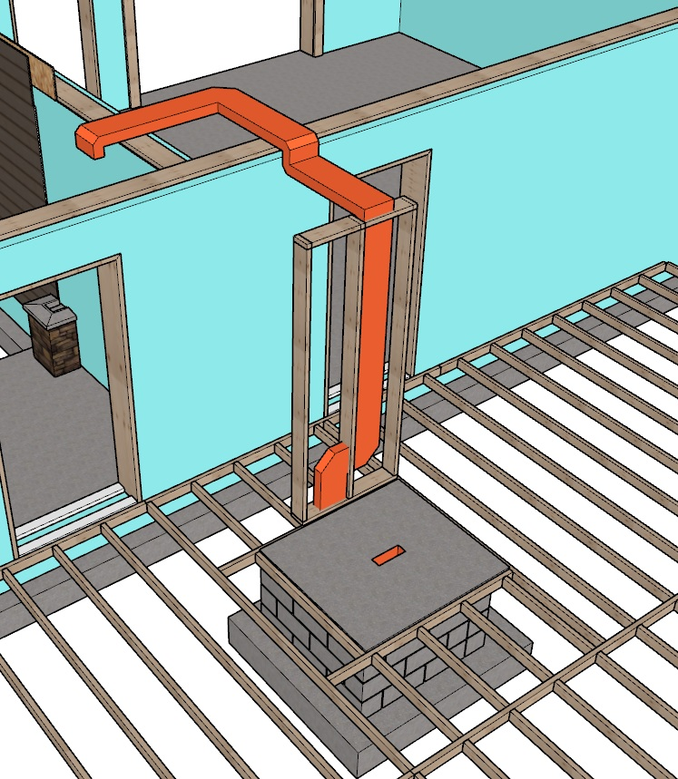
OUTSIDE AIR INTAKE
GROUND FLOOR PAD
CINDER BLOCK WALLS
LOWER PAD

Slide 9
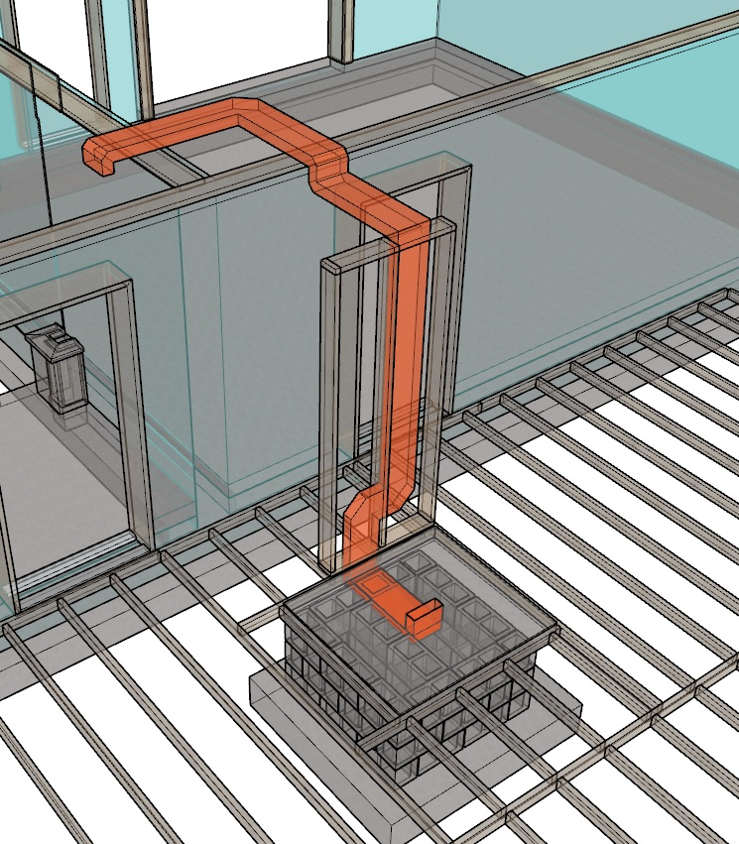

Slide 10
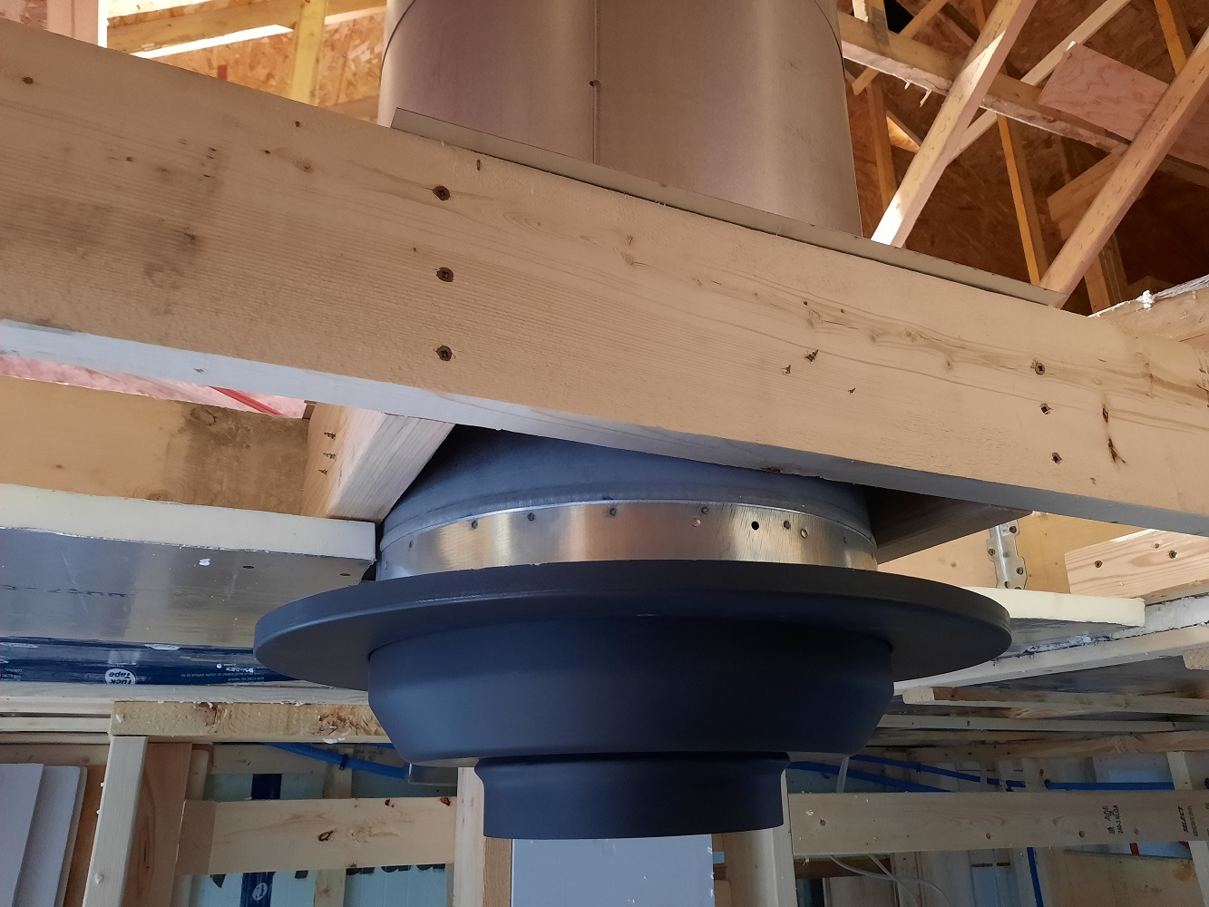
PREFAB 8 INCH CHIMNEY WITH HEAT SHIELD

Slide 11
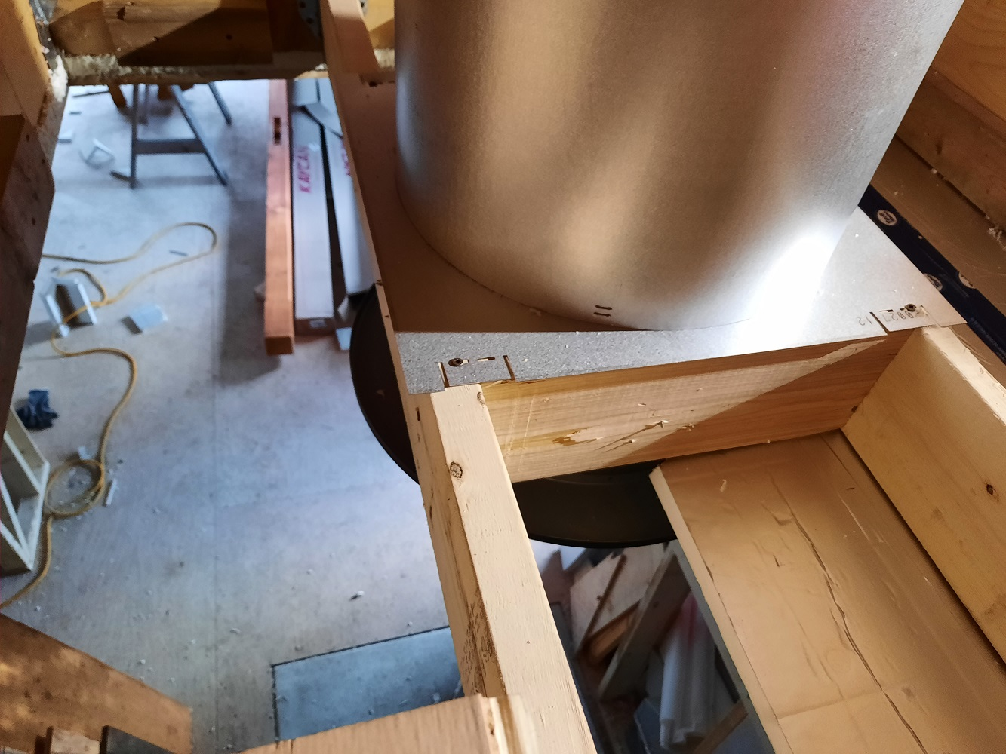

Slide 12
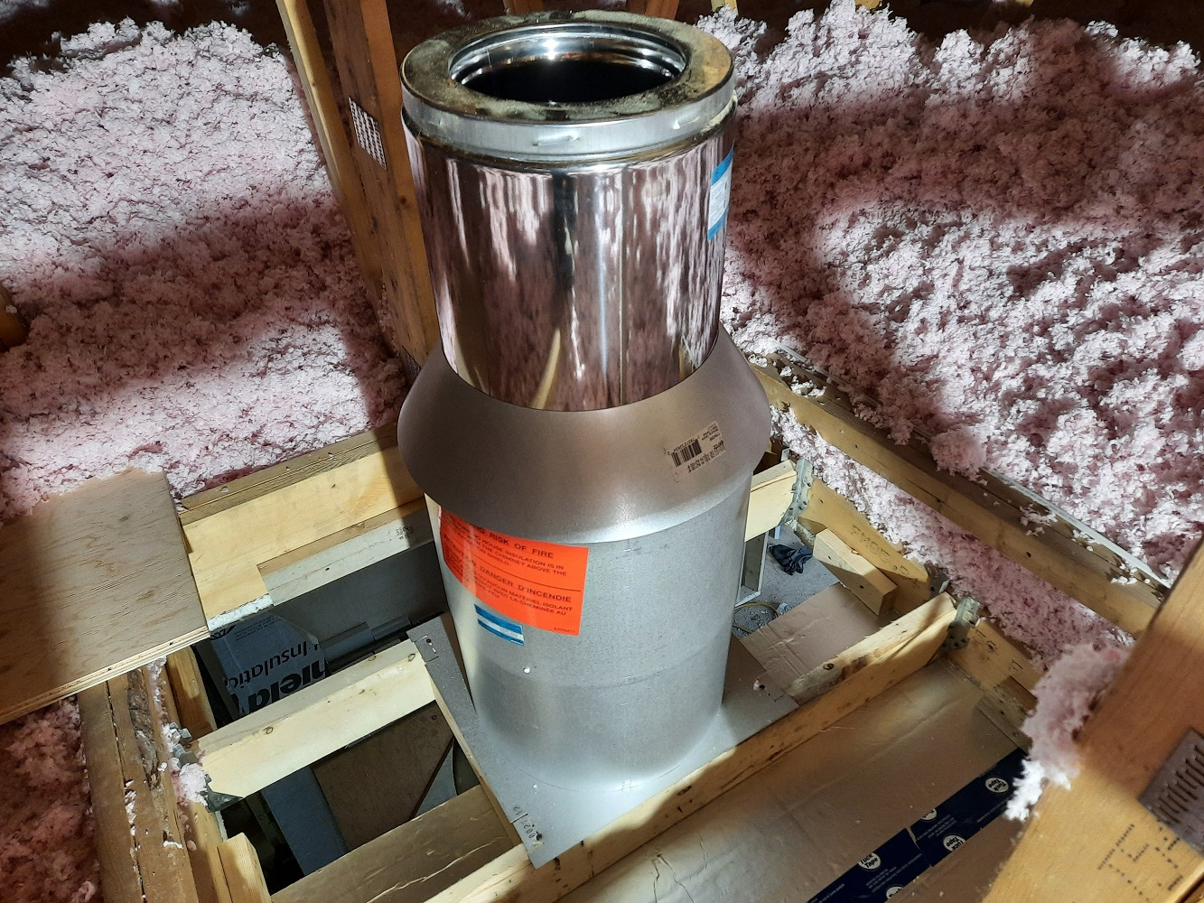
PREFAB 8 INCH CHIMNEY WITH HEAT SHIELD INSTALLED ACCORDING TO MANUFACTURERS SPECIFICATIONS

Slide 13
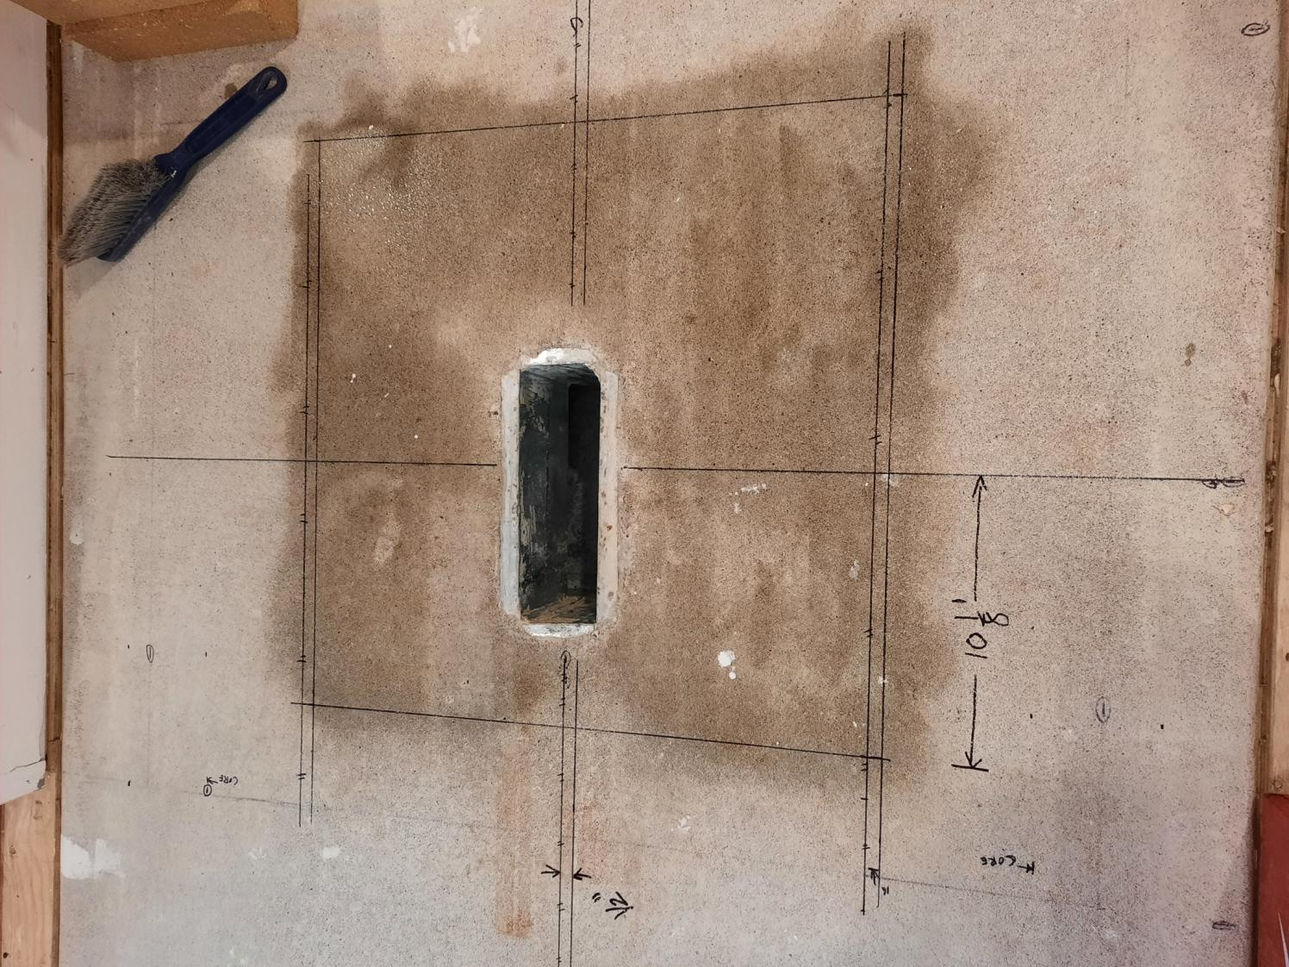
STARTING LAYOUT

Slide 14
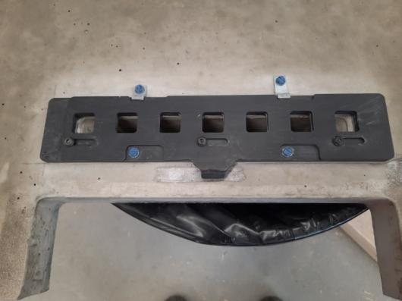
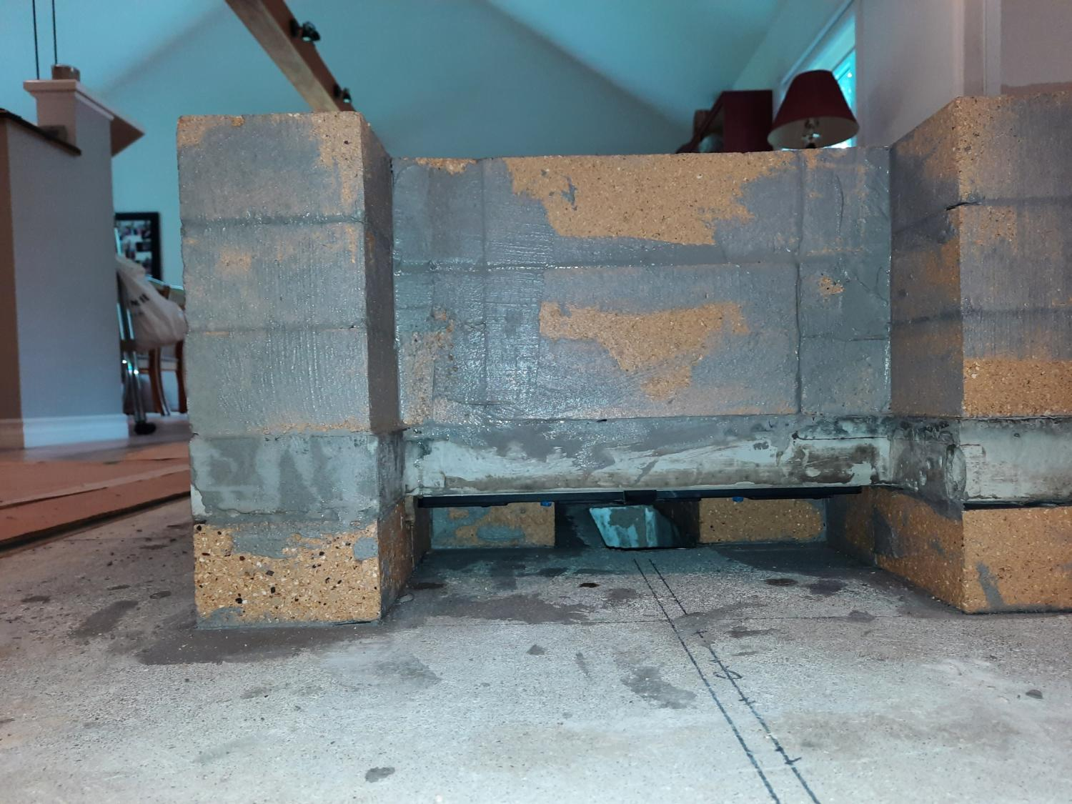
ASHBOX AIR INLET DAMPER
OUTSIDE AIR INLET

Slide 15
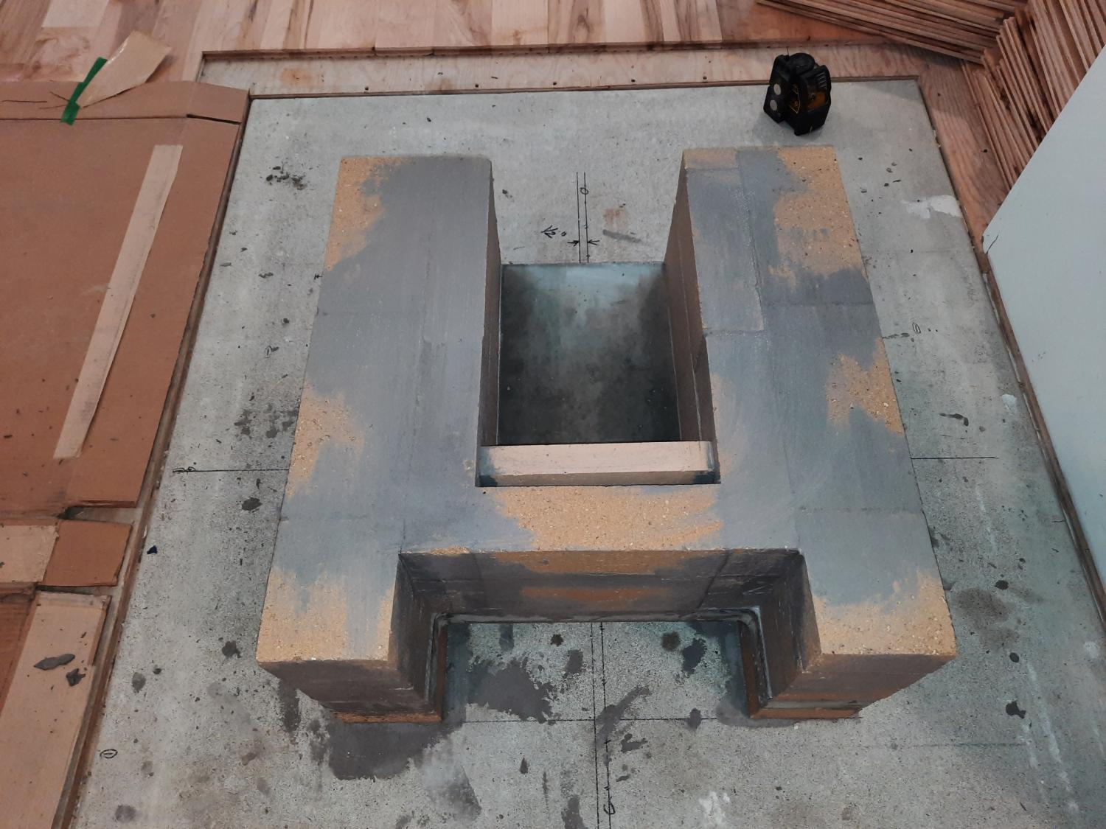

Slide 16
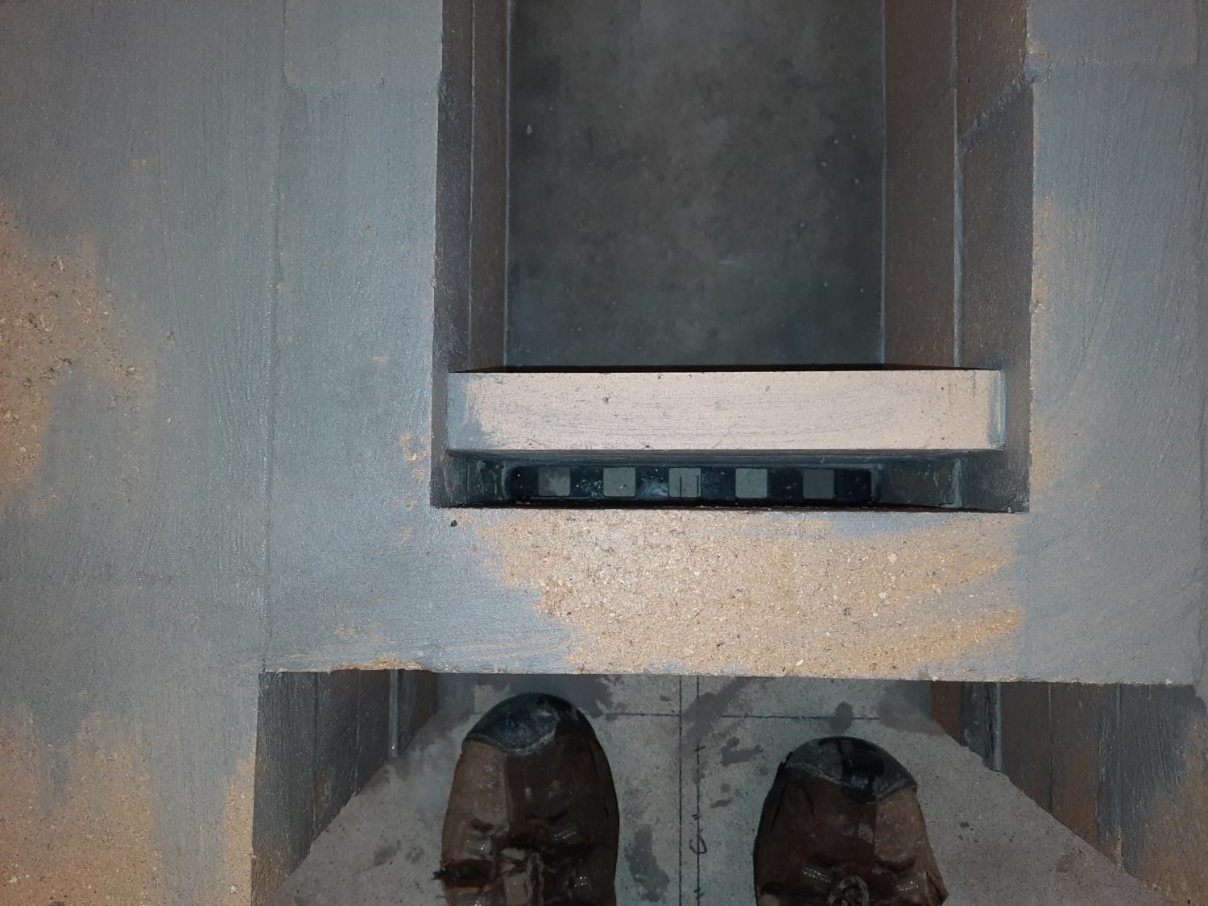

Slide 17
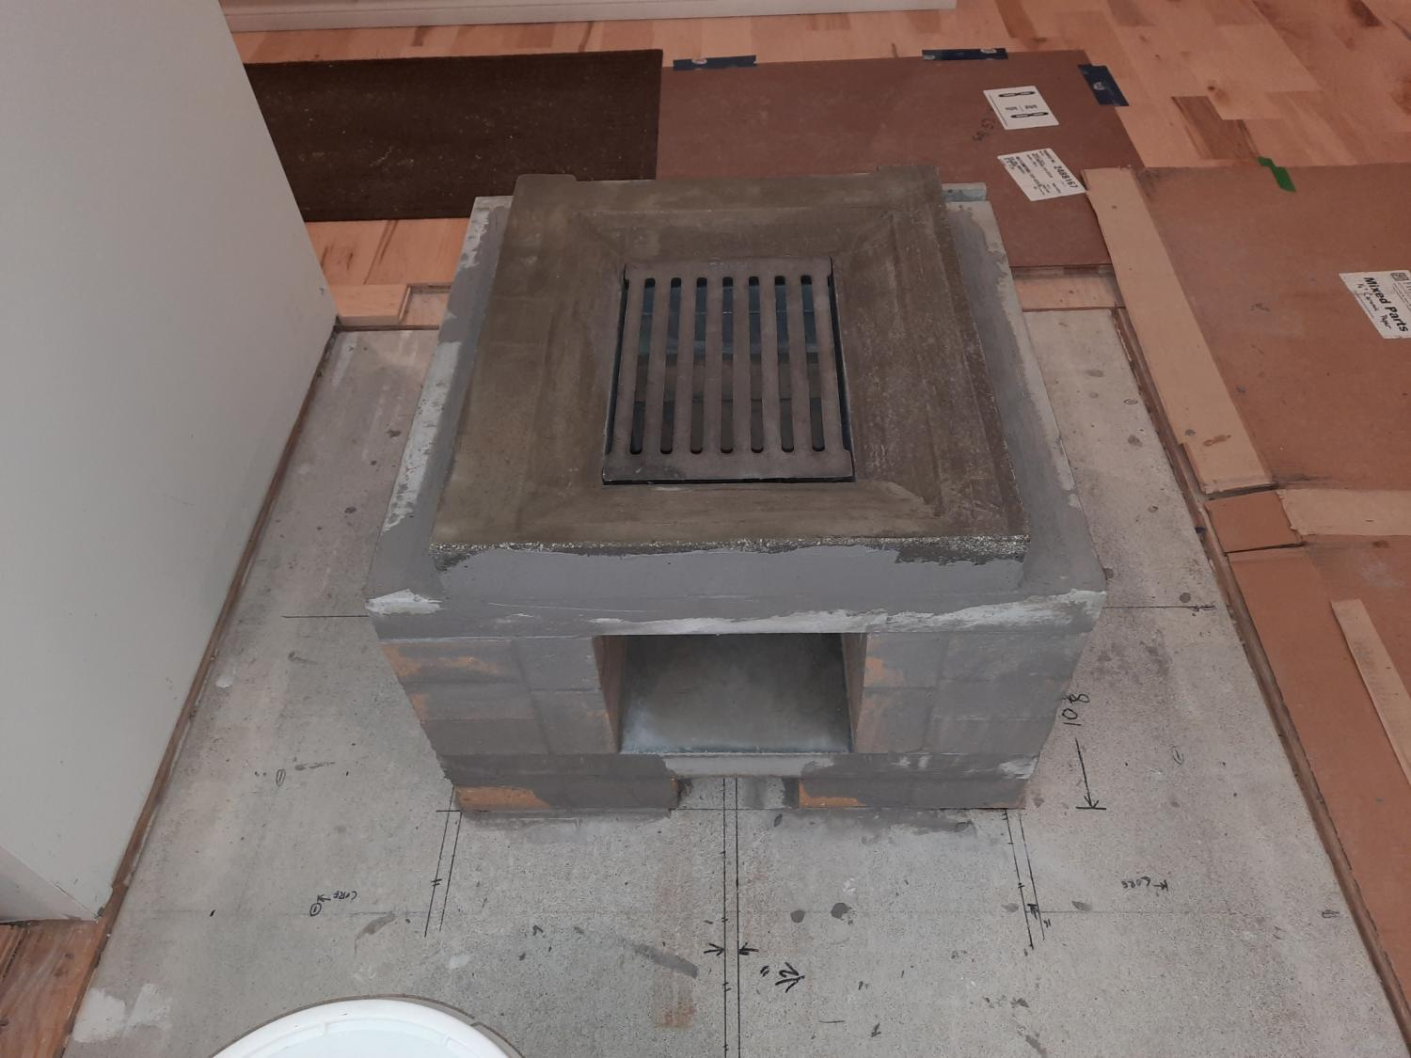

Slide 18
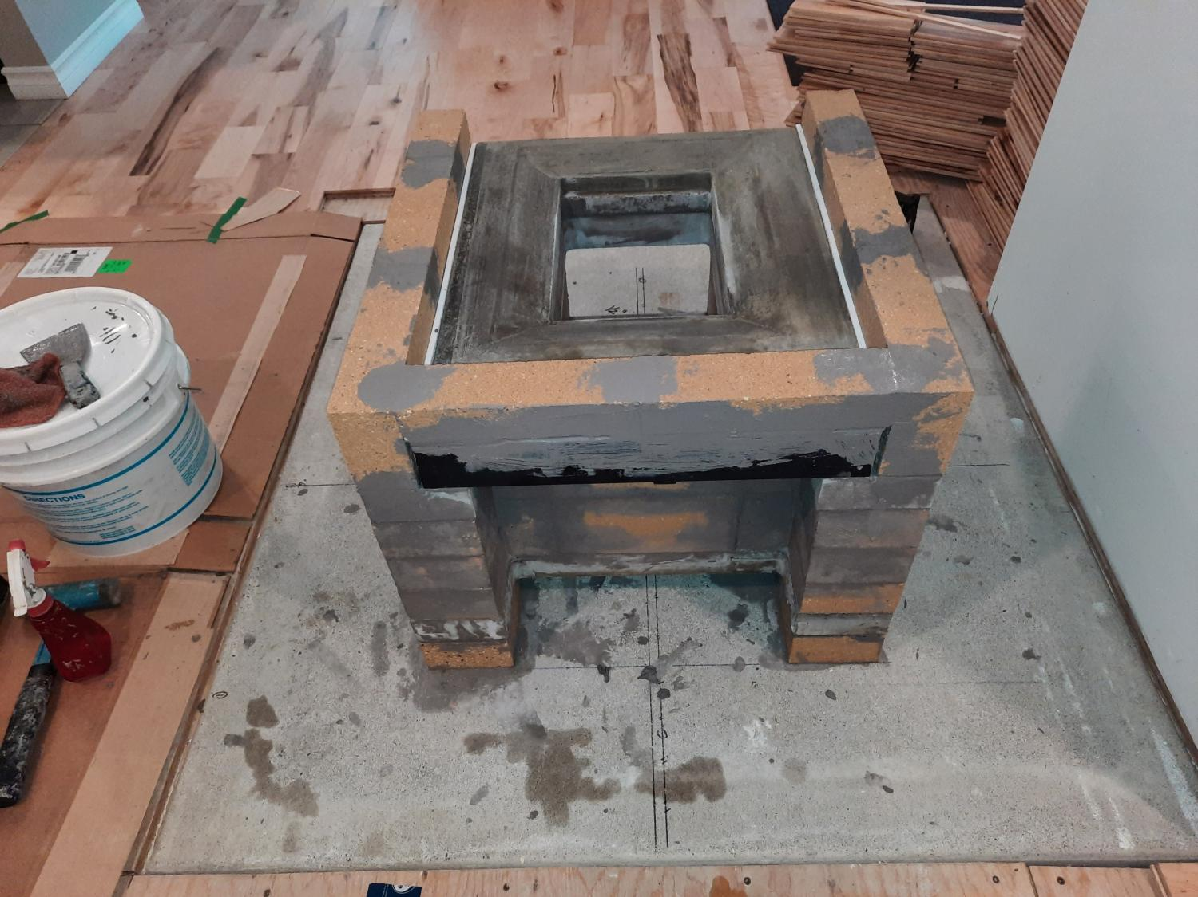

Slide 19
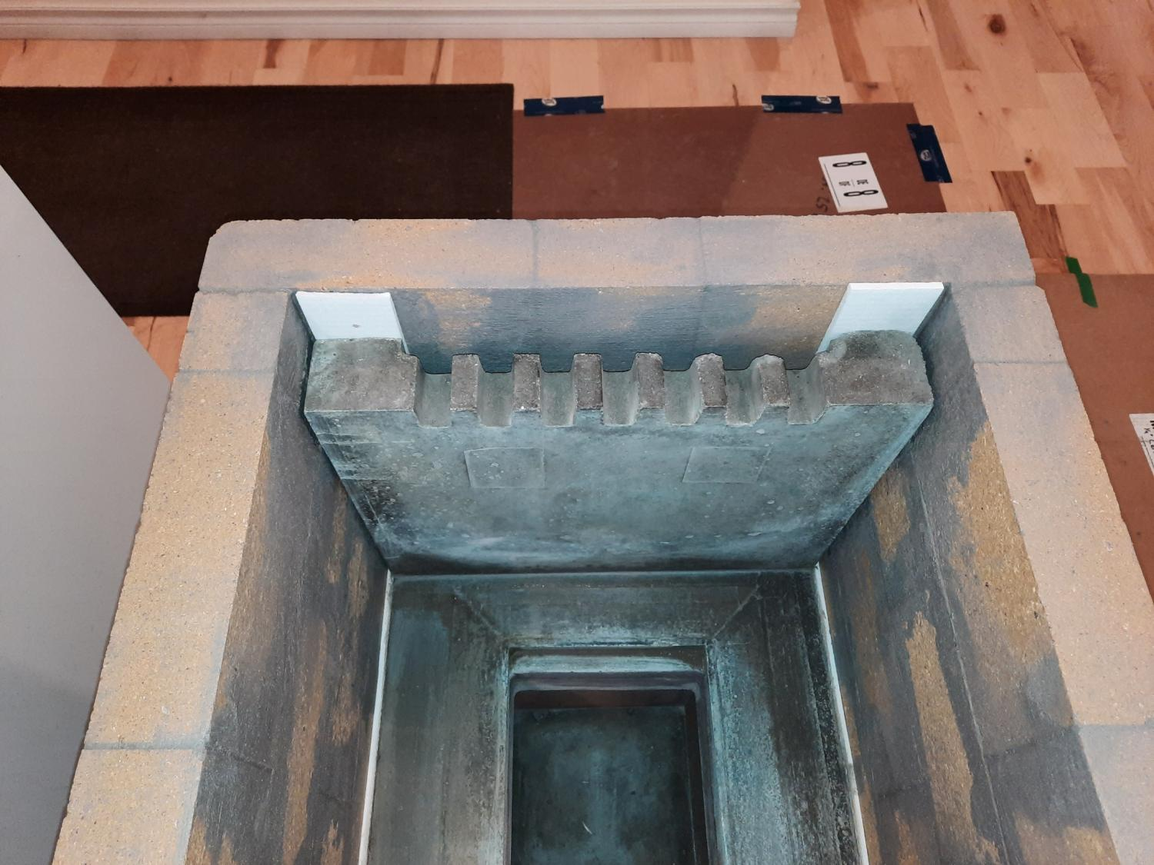
FIREBOX AIR INLET

Slide 20
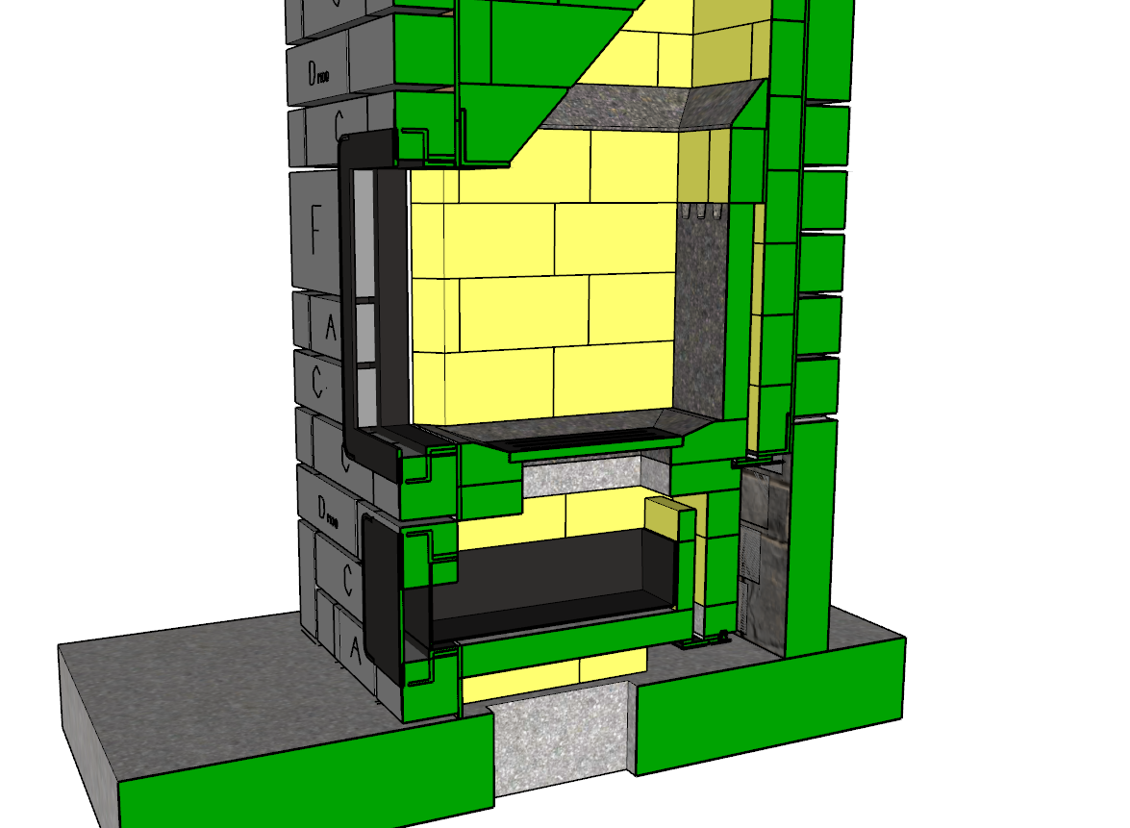
SKETCHUP FILE
CAST REFRACTORY CONCRETE SLABS
FIREBOX AIR INLET DAMPER
ASHBOX AIR INLET DAMPER
OUTSIDE AIR INLET

Slide 21
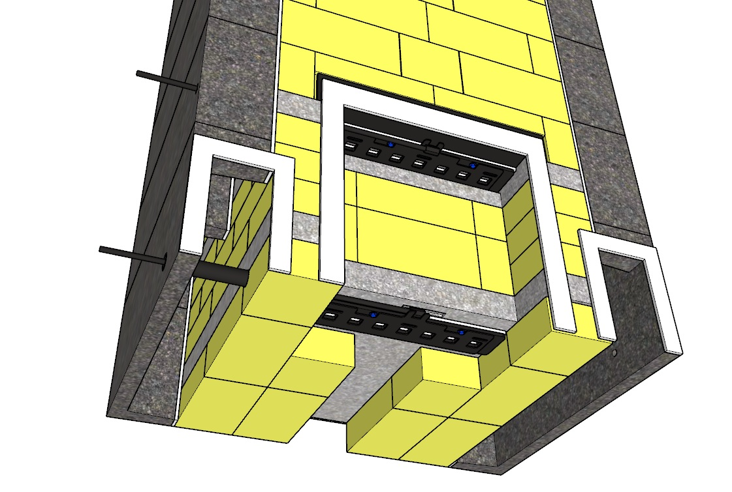
REAR OF CORE
AIR INLET PUSH PULL ROD TO OPEN AND CLOSE DAMPERS
FRESH AIR INLET DAMPERS
BOTTOM OF CORE

Slide 22
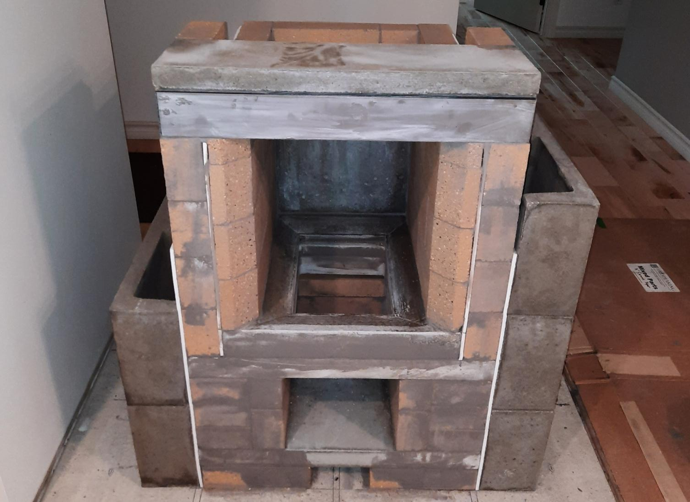

Slide 23
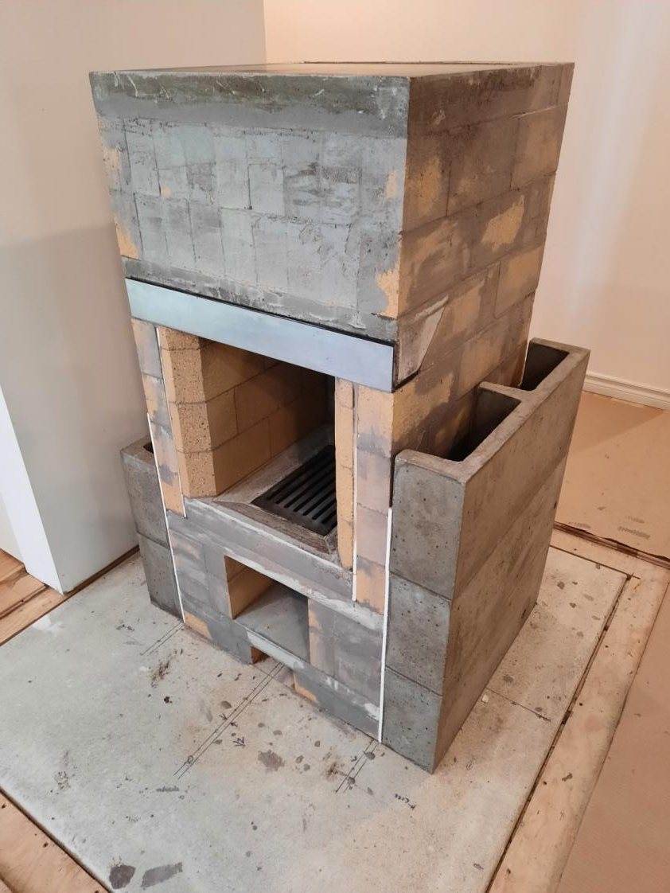
OVEN COOK SURFACE
STAINLESS LINTEL CAP OVER ANGLE IRON LINTEL
CAST CONCRETE AIRWAYS

Slide 24
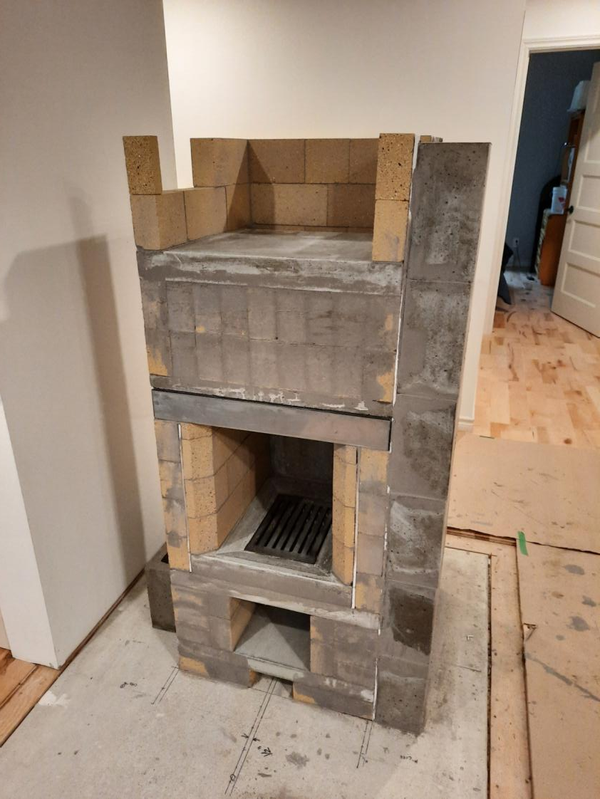

Slide 25
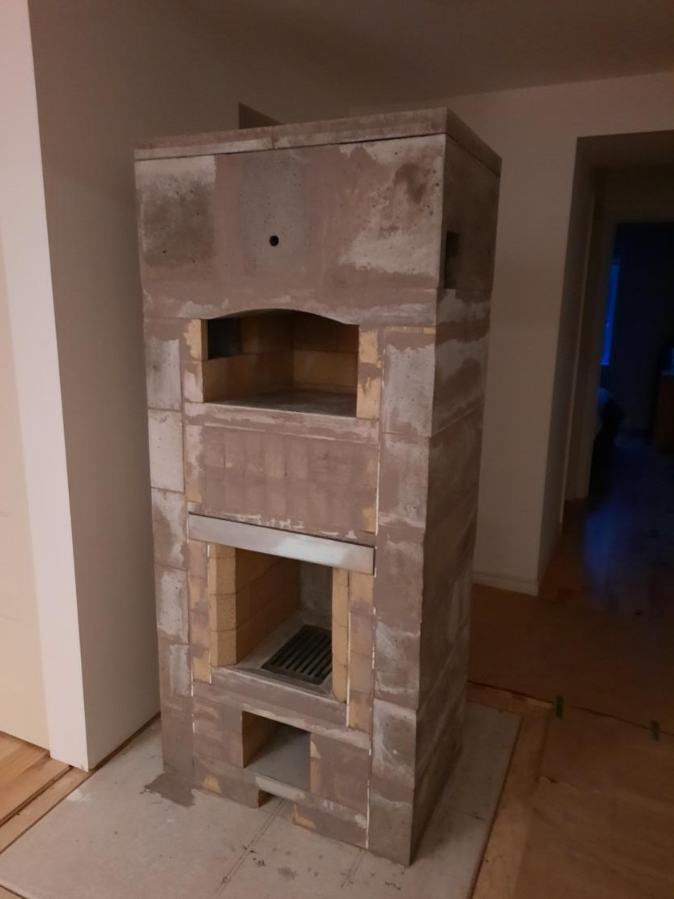
FINISHED MASONRY HEATER CORE

Slide 26
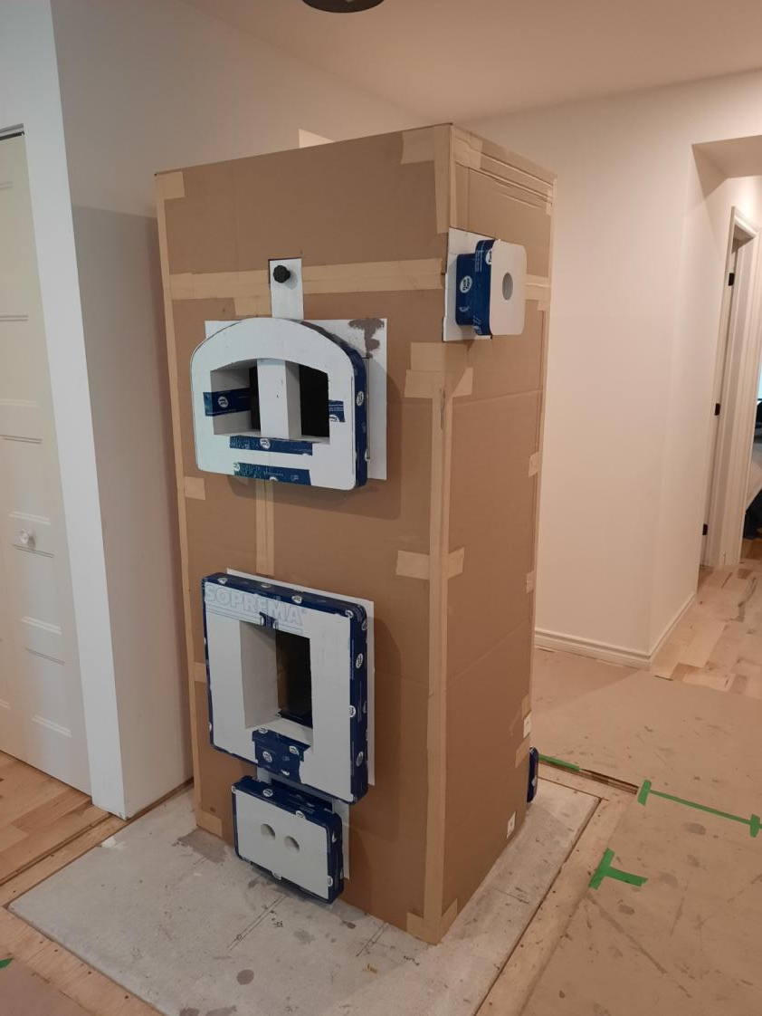
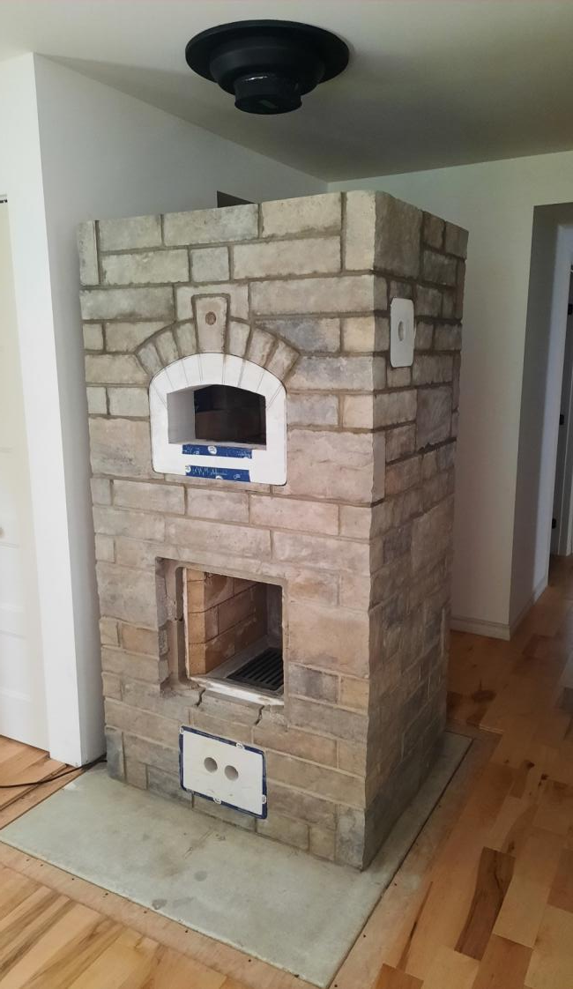
CORE COVERED IN 1/4 INCH CARDBOARD
STYROFOAM FORMS FOR DOORS AND CLEANOUT

Slide 27
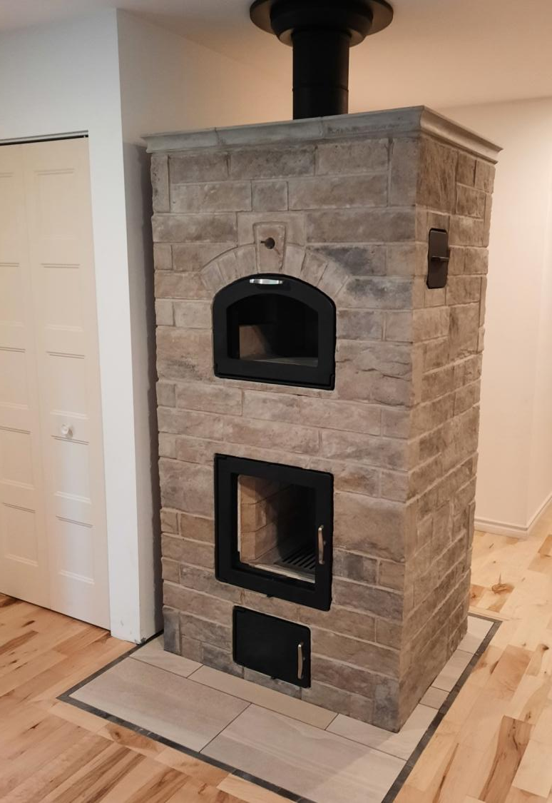
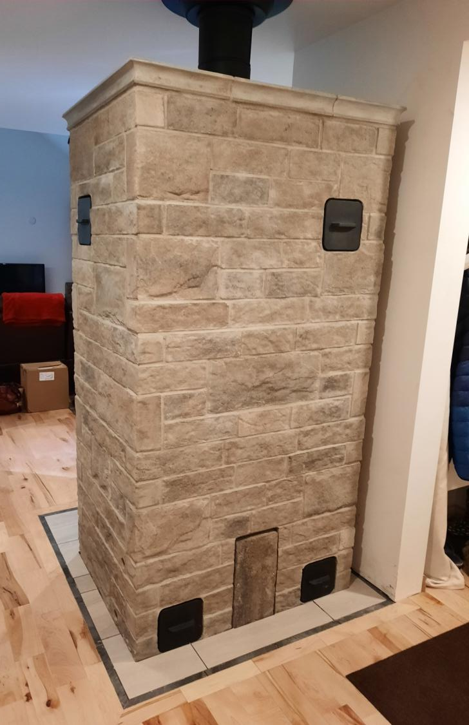
CUSTOM CONCRETE TOP
DOORS MOUNTED FLUSH WITH BRICK
CONCRETE BRICK FOR FINISHING LAYER

Slide 28
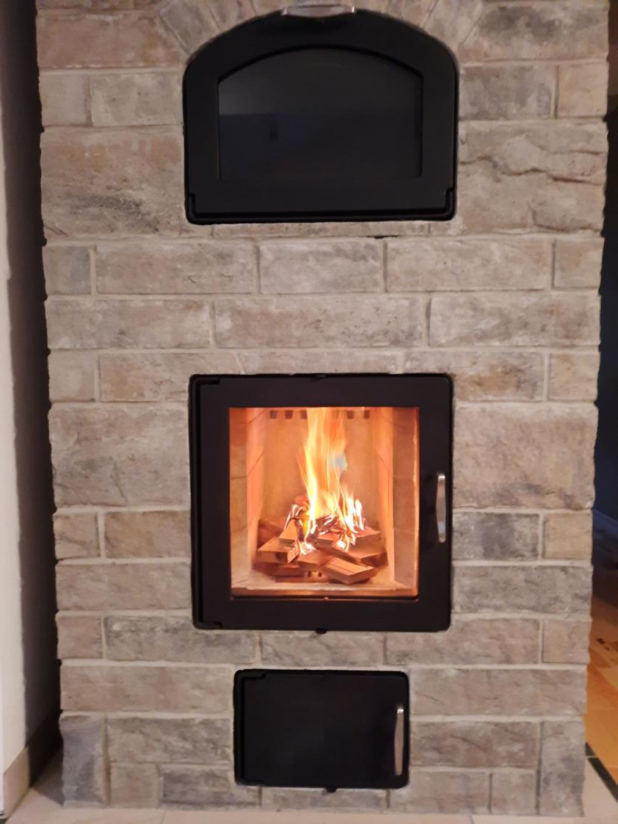
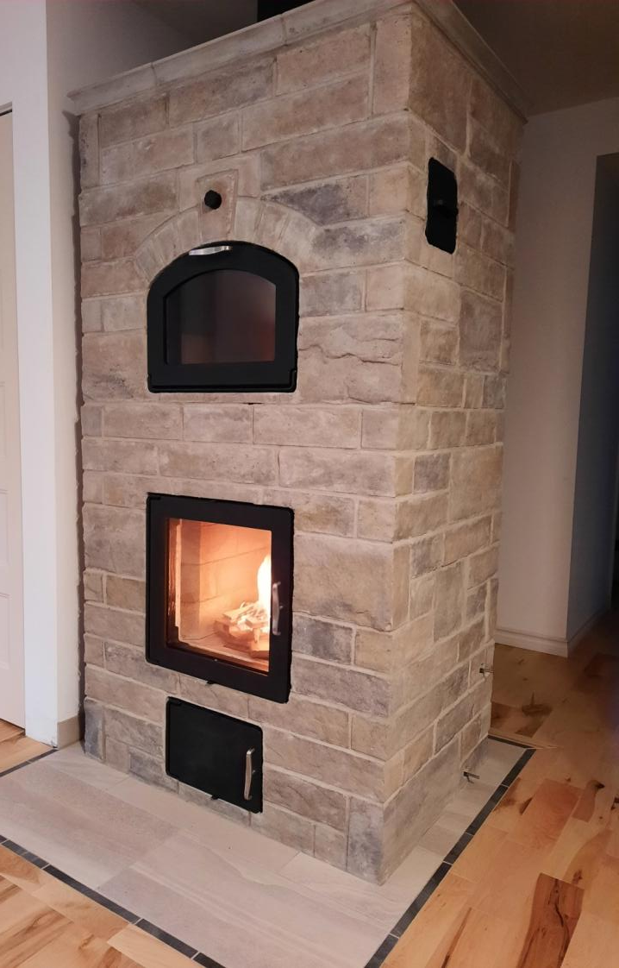
FIRST FIRE

